Slide 1

Visualization and Analysis – Tutorial Presentation for Feedback Date:
Group Id: Name of Student Presenting:

Slide 2
If you have not defined your Research Question (RQ) yet, please do not attempt to present Visualisations and/or analyses of your data. Go to Canvas, announcements on RQ presentations, and use the PowerPoint template provided for you to present your RQ. You can use the time slot to present your RQ instead of the Visualisation.
Part 1: VISUALISATION

Slide 3
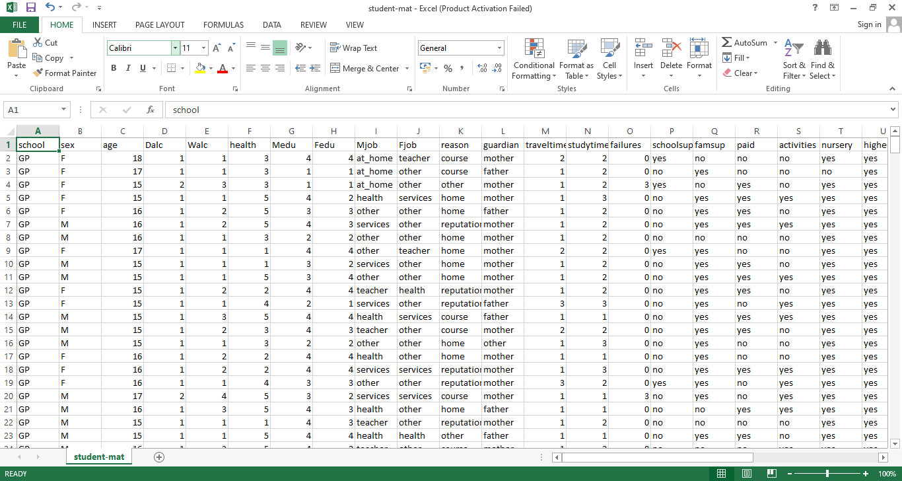
We are using the dataset (DS294 – Student-mat.csv) to answer our Research Question “Ordinal vs. Nominal data : “Is there a difference in the mean of Age, Dalc, Walc between and Health”. How different Age of students are habituated to drinking and how the rest of the attributes interlinked to the student lifestyle? ”
Our Independent variable : Age, Dalc, Walc This Independent variable data type : Nominal Data Our Dependent variable: Health This Dependent variable data type : Ordinal data
Data set has 396 rows, 33 Columns

Slide 4
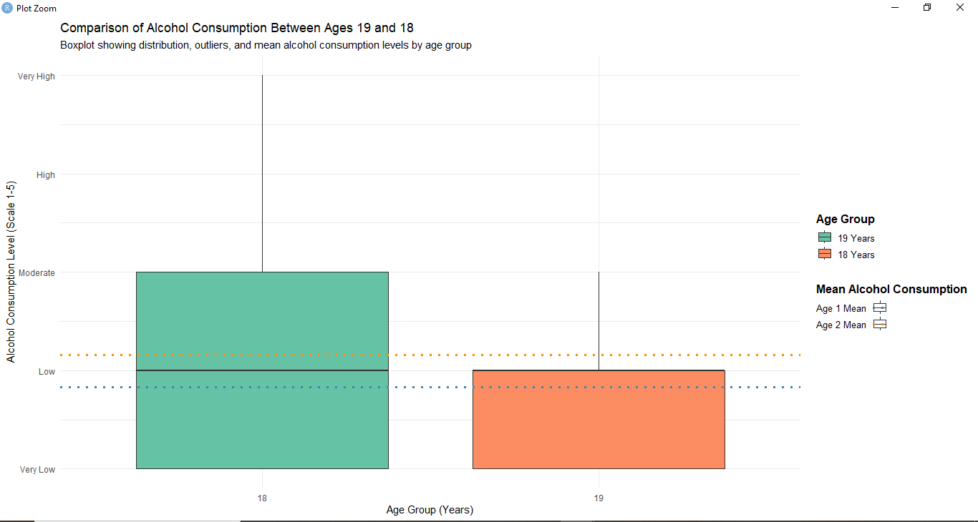
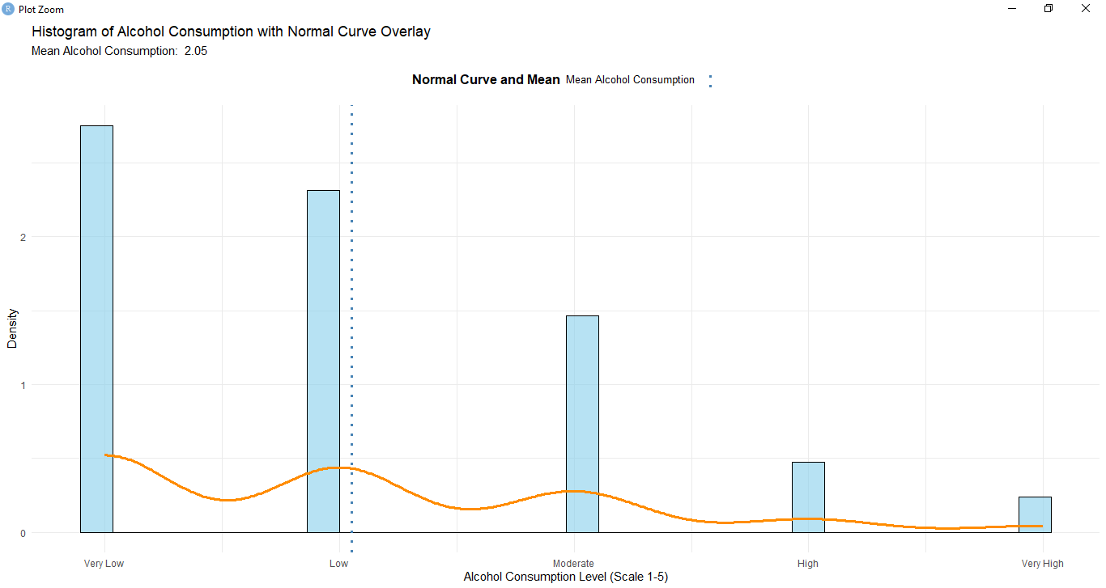
1. Boxplots (to include outliers) (place the dependent variable on the y-axis and independent variable sub-categories on the x axis) 2. A histogram to include the normal curve overlay. The histogram plots data from your dependent variable only.
2. Where your research question asks about Comparison of means/medians: Include two plots
Boxplot visualization
Histogram visualization

Slide 5
Only attempt this Analysis part of the demo if you have completed your Visualization(s). Otherwise end your demo after the Visualization for feedback.
Part 2: Analysis (building on your Visualizations)

Slide 6
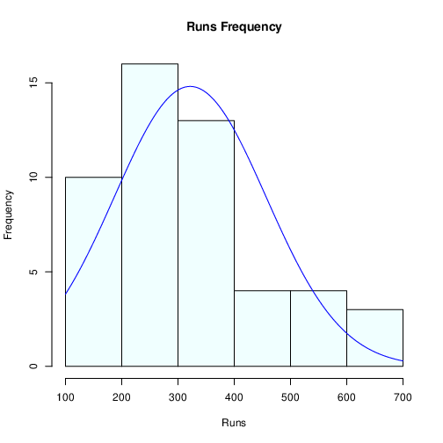
Here is a Histogram showing the frequencies of our dependent variable to include the normal curve overlay (shown in blue).
Our RQ asks about Differences in means/ medians
For example:
Choose one:
1. The normal curve overlay follows the contours of the underlying data, so we use the parametric test: t-test.
OR
2. The normal curve overlay does not follow the shape of the underlying data, so we use the non-parametric test that does not assume normality: Wilcoxon also known as the Mann Whitney U Test.
The example here is borderline, in terms of shape, so when in doubt choose the non-parametric equivalent.
6

Slide 7
R Script and Results (For ALL types of test) – The Analysis
PRE 7COM1079-2022 Student Group No: ?????
7
Include a snippet of the R code you use to calculate your test statistic.
Give the value of the test statistic.
Tell us the p-value. Is it > or < 0.05?
Is the result significant?
Do you accept or reject the null hypothesis?
What does the result actually mean in the wider context of learning something useful / answering your RQ?
Notes:
7

